Slide 1

Files
Chapter 7

Slide 2



Opening a file
Python can locate a certain file with the open function
Read
Write
Append
Close
Etc.
.xlsx
.csv
.tsv
.txt
.py

Slide 3
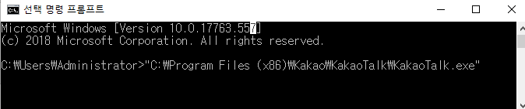
File handler
File handler is used to do something with a file within python
handler = open(file, mode)
1. Name of the file
2. Function to open a certain file
3. Name/location of a file
4. Mode of the open function

Slide 4

Modes of open()
handler = open(file, mode)
Welcome! This page is only for discussing the contents of the Main Page. It isn't for general questions unrelated to the Main Page or for the addition of content to Wikipedia articles.
“r” = for reading only
“r+” = for reading and writing
“w” = for overwriting a file
“a” = for appending to a file

Slide 5
Modes of open()
handler = open(file, mode)
Welcome! This page is only for discussing the contents of the Main Page. It isn't for general questions unrelated to the Main Page or for the addition of content to Wikipedia articles.
“r” = for reading only
“w” = for overwriting a file
“r+” = for reading and writing
“a” = for appending to a file

Slide 6
Modes of open()
handler = open(file, mode)
Welcome! This page is only for discussing the contents of the Main Page. It isn't for general questions unrelated to the Main Page or for the addition of content to Wikipedia articles.
“r” = for reading only
“w” = for overwriting a file
“r+” = for reading and writing
“a” = for appending to a file

Slide 7
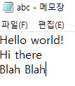


File handle sequence
abc.txt
File handle sequence
result
File handle sequence
Reads each line of file
For in = for each line in

Slide 8
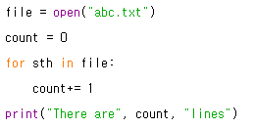
File handle sequence
Counting the number of lines in a file
Opening a file
Creating a variable ‘count’
For each line in ‘file.txt’
Add 1 to count
Printing the result

Slide 9
#newline characters
In python, we express a change of line with ‘\n’
Ex)
Gallimimus was a theropod dinosaur that lived in what is now Mongolia about 70 million years ago, during the Late Cretaceous.
What you see on the web
How python sees the same text
Gallimimus was a theropod dinosaur that\n lived in what is now Mongolia about 70\n million years ago, during the Late/n Cretaceous.

Slide 10


#newline characters
This is applied within python as well

Slide 11
Reading a file
str_file = open(‘abcd.txt’).read()
.read() : function that converts whatever inside a txt file into a string
str_file =“whatever was inside the text file

Slide 12
Counting the number of words in a text
File handler : lets us do something to a file
len(x): returns the length of x
Can we count how many words there are in a text file?
We will be reading “wiki.txt”
len() only works on strings

Slide 13
1. open the file
2. convert the file into a string
3. get the length of the string

Slide 14

Counting the number of words in a text
File handler
Converting file with read()
Printing the length of string
= How many words are in the file?

Slide 15
Extracting only what we want
Remember the functions we learned in ‘strings’?
line.startswith()
line.endswith()
How can we get the lines with the information we want?

Slide 16
Extracting only what we want
Situation: from ‘wiki.txt’ , we only want the lines that start with ‘From’
How can we make python print the lines that start with ‘From’?
How can we print lines that do not start with ‘From’?

Slide 17
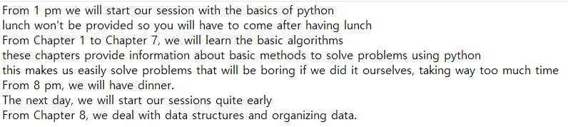
Extracting only what we want
wiki.txt

Slide 18
1. open the file! (wiki.txt)
2. for each line in the txt file
3. if the line startswith “From”
4. print

Slide 19
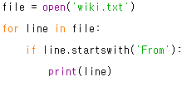
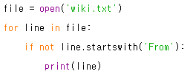
Extracting only what we want

